Slide 1

Innovation and Models Supporting Scale Up of Clean Cooking Success Stories
Dr.-Ing. Matthew Josephat MATIMBWI
matimbwi@tarea-tz.org

Slide 2
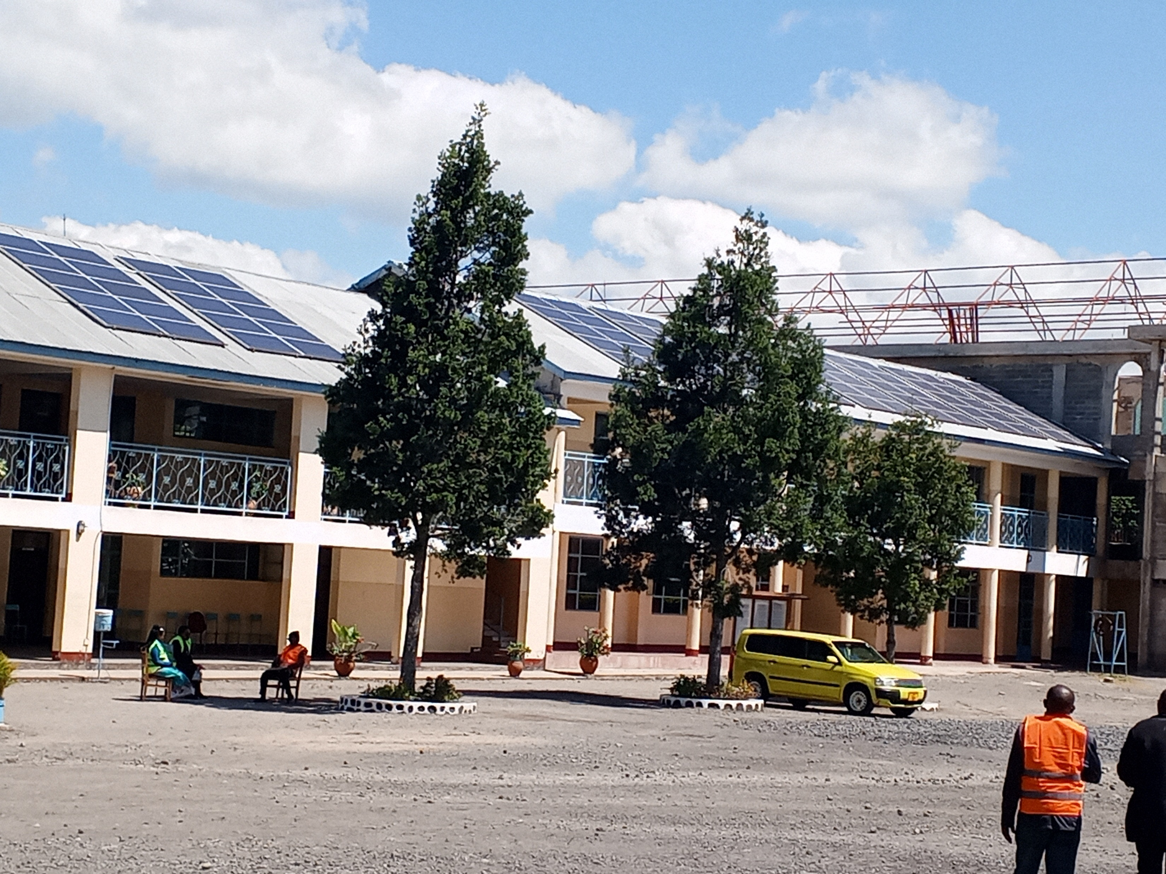
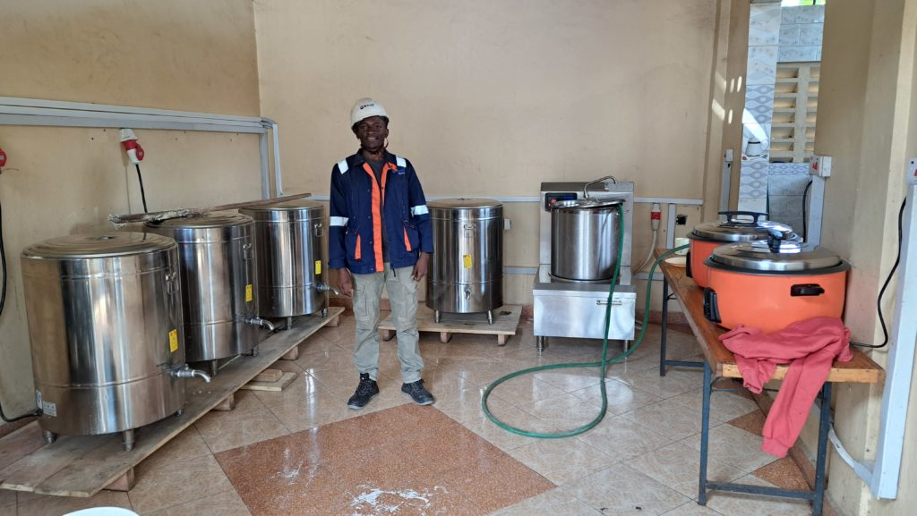
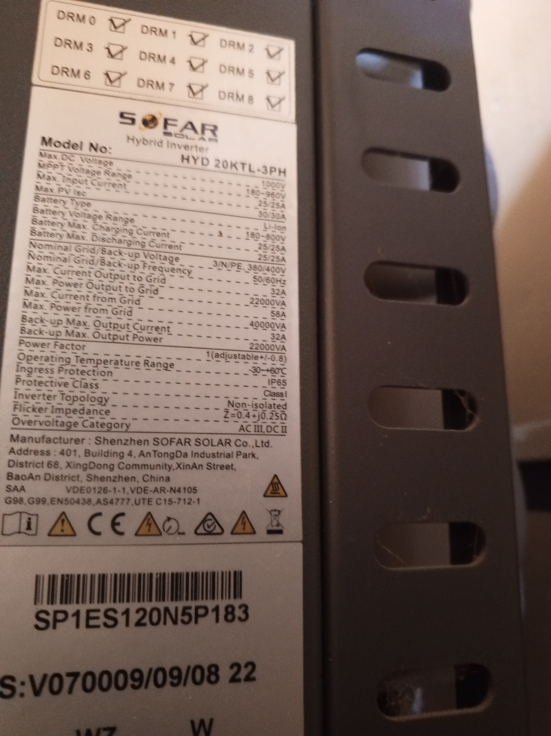
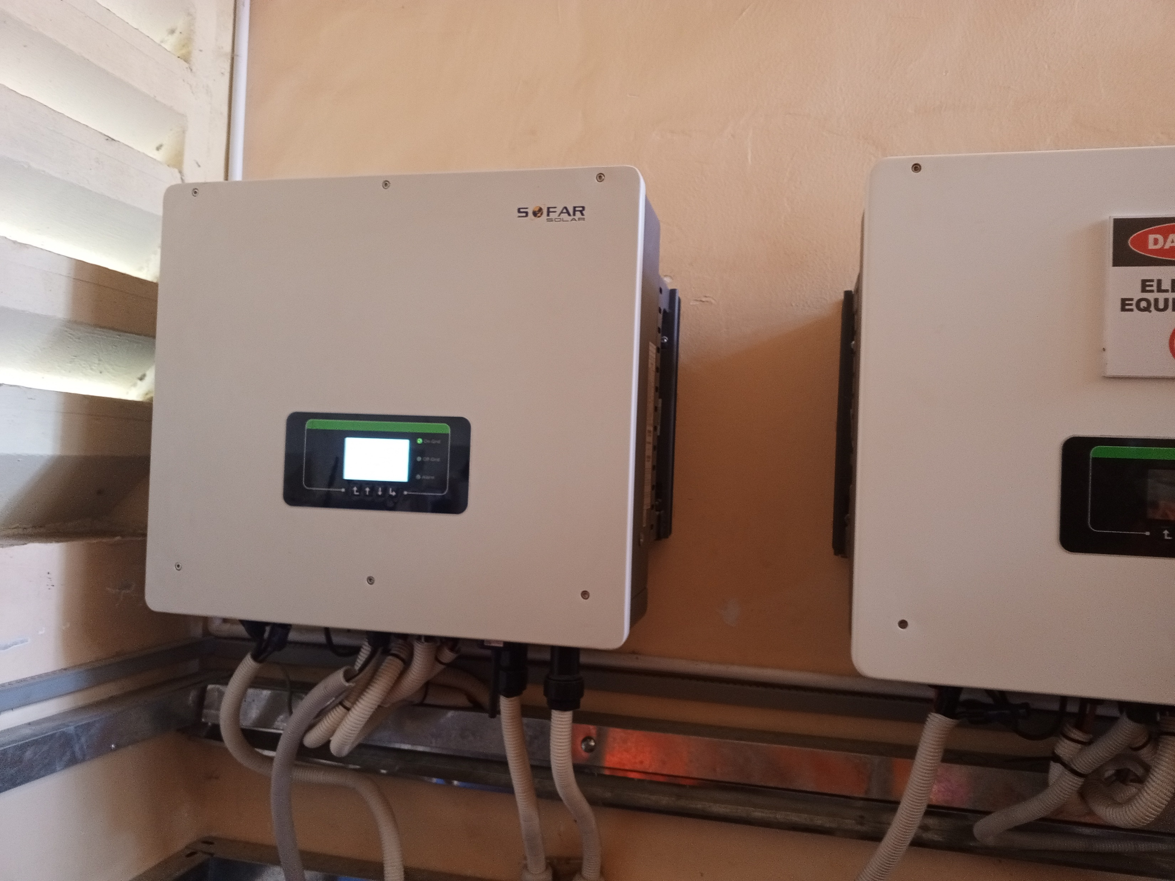
Solar Photovoltaic Technology

